Slide 1
Problems with “Inferred Latches” in Verilog
ECE 111

Slide 2
The “Inferred Latch” Problem
In a combinational always statement, always@(*), and functions, “case” and “if-then-else” statements must be completely specified for all signals.
If not, Quartus will generate asynchronous “latches”, which are BAD (and NOT ALLOWED for the RLE and SHA1 projects) !!

Slide 3
The “Inferred Latch” Problem
Asynchronous “latches” are BAD for the following reasons:
Most (if not all) industry chip designs follow a “synchronous” design methodology where all flip-flops must be controlled by the same clock.
Not all FPGAs and ASIC cell libraries support asynchronous latches.
Difficulty with timing closure and accurate timing analysis.
Unpredictable behavior.

Slide 4
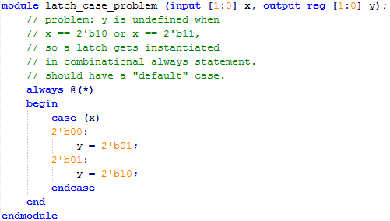
Example: latch_case_problem.v

Slide 5
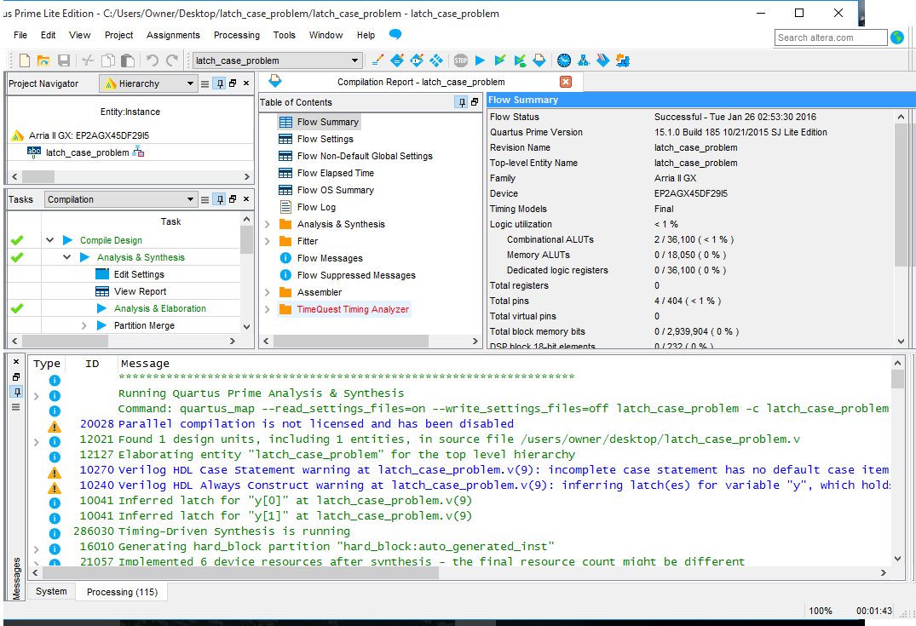
Example: latch_case_problem.v

Slide 6
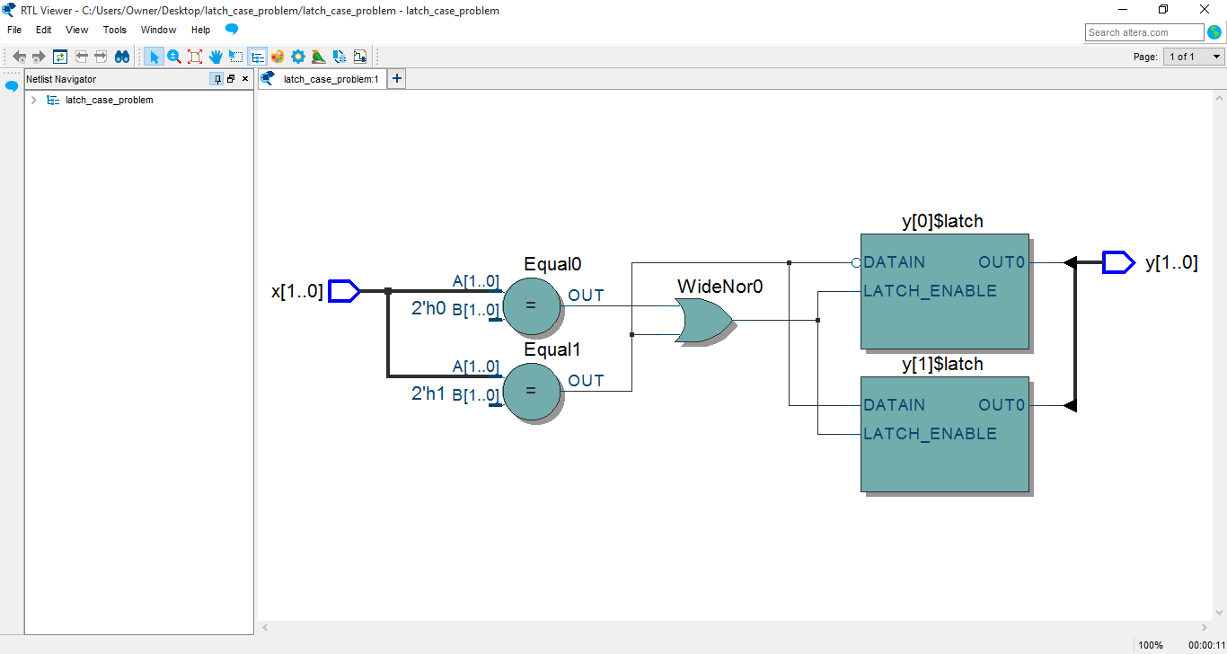
Example: latch_case_problem.v
asynchronous latches are BAD and not allowed

Slide 7
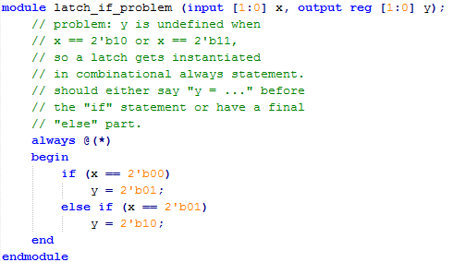
Example: latch_if_problem.v

Slide 8
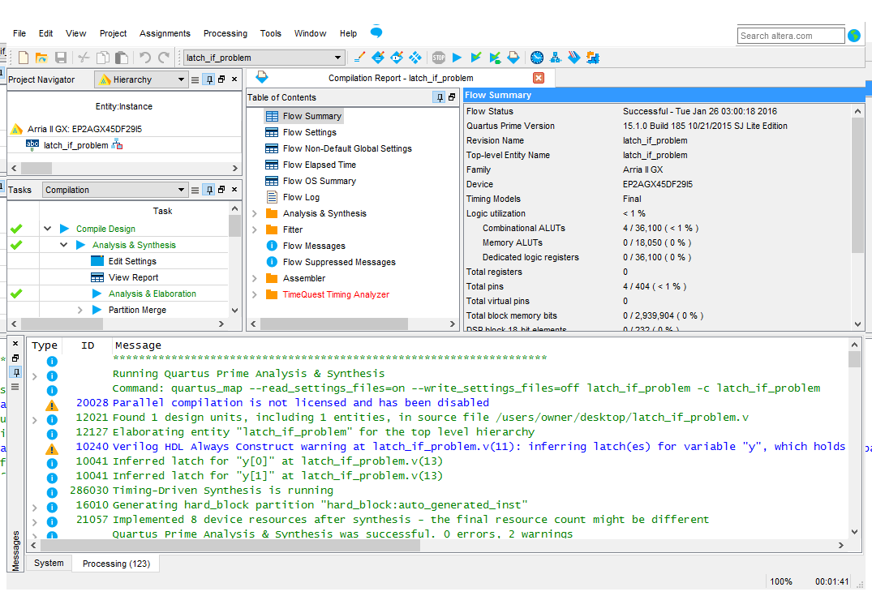
Example: latch_if_problem.v

Slide 9
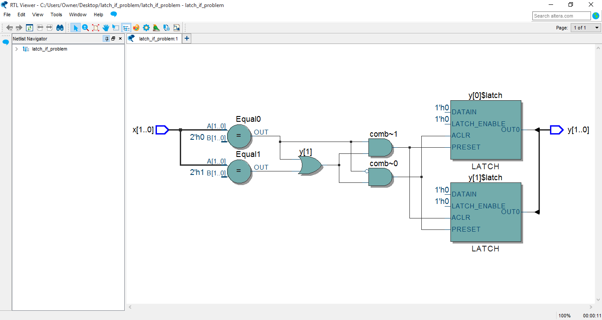
Example: latch_if_problem.v
asynchronous latches are BAD and not allowed

Slide 10
Make Sure Your Designs Do Not have Inferred Latches

